Slide 1
Thanks for Joining Us!
Listen to audio over your computer speakers. If you are not able to listen via the Internet, you can dial-in by phone using the numbers shown on your screen.
If you disconnect, simply repeat instructions to reconnect to the program.
If listening to audio by phone, you can adjust the volume by pressing *4.
To submit a question, type in the chat window and click “Enter” to send.
CPE and CEU Credits are NOT available for this forum.

Slide 2
Welcome to FYI
Our Intent and Purpose
Strategic Plan Outreach and Mentorship Effort for New and Newer PASBO Members in all aspects of School Business Management
Use PASBO Experts to Help New Entrants
Continuing Series
Thursday, September 11, 9:00 a.m.
All sessions recorded and available
at www.pasbo.org/FYI
Who Are You?—Let’s Find Out

Slide 3
Today’s Agenda
What's Due
Calendar of State and Federal Reports
From the Experts
PASBO Tools You Can Use
Resources to Help You
Your Questions Answered
An Open Forum for Your Questions About Topics Covered and Uncovered!

Slide 4
Before We Start
The due dates on the calendar are intended as a guide not as absolute deadline dates.
The calendar is a work in progress and will be modified throughout the year.
This is not an “official” calendar although it has been reviewed by PDE.

Slide 5
Sources of Filing and Reporting Info
PIMS Data Collection Calendar
http://www.portal.state.pa.us/portal/server.pt/community/pims-pennsylvania_information_management_system/8959
Comptroller Forms
http://www.portal.state.pa.us/portal/server.pt/community/forms_and_procedures/13472
Food Service Calendar
http://www.portal.state.pa.us/portal/server.pt/community/national_school_lunch/7487/activity_calendar/964588

Slide 6
1-Jul | New Hire Report | Monthly | Report of New Hires | HR | Dept. of Labor & Industry
1-Jul | NSL Report on PEARS | Monthly | Reimbursement for Lunches Served each Month | Food Service | CN PEARS
1-Jul | PDE-2095 | Annual | IU Transportation Budget | Transportation | DPT
10-Jul | 4059A | Annual | Pupil Membership/Child Accounting Reports (career-tech) | Child Accounting | PDE
10-Jul | Upload NPAS Reports and Send On-line | Monthly | Report of Wages & Retirement Contributions | Finance | PSERS/NPAS
10-Jul | 40591 | Annual | Pupil Membership/Child Accounting Reports (intermediate units) | Child Accounting | PDE
15-Jul | PDE 4104 | Annual | Practical Nursing Student Instructional Hours |  | Bureau of Career & Technical Edu.
15-Jul | 374 | Annual | Expenditures for Edu. Of Juveniles incarcerated in adult facilities (budget) | Finance | DSD&A
15-Jul | PDE 2028 | Annual | General fund annual budget | Finance | DSD&A
15-Jul | Cert. of Ending Fund Balance | Annual | Certification of estimated ending fund balance from prior year general fund budget | Finance | PDE
15-Jul | Cert. of Use of Referendum Exceptions | Annual | If referendum exceptions approved, file certification of use | Finance | PDE
15-Jul | Tax Levy Resolution | Annual | Submit copy of annual tax levy resolution | Finance | DCED
30-Jul | PDE-352 | Annual | ACCESS Funds Request Form | Finance | PDE
31-Jul | 941 | Quarterly | Employer's Quartery Federal Tax Return | Finance | IRS
31-Jul | PDE-2105 | Annual | Reconciliation of Social Security & Medicare | Finance

Slide 7
1-Aug | New Hire Report | Monthly | Report of New Hires | HR | Dept. of Labor & Industry
1-Aug | NSL Report on PEARS | Monthly | Reimbursement for Lunches Served each Month | Food Service | CN PEARS
1-Aug | 4014CS | Annual | Pupil Membership/Child Accounting Reports (charter schools) | Child Accounting | PDE
1-Aug | 4059K | Annual | Pupil Membership/Child Accounting Reports (school districts) | Child Accounting | PDE
10-Aug | Upload NPAS Reports and Send On-line | Monthly | Report of Wages & Retirement Contributions | Finance | PSERS/NPAS
25-Aug | Bus Evacuation - PDE 4101 | Semi-Annual | School Bus Evacuation Drill | Transportation | DPT
30-Aug | PDE-352 | Annual | ACCESS Funds Request Form (school district) | Finance | PDE
31-Aug | PDE-363 | Annual | Funding for Charter school | Finance | DSD&A
31-Aug | 374 | Annual | Expenditures for Edu. Of Juveniles incarcerated in adult facilities (final) | Finance | DSD&A

Slide 8
1-Sep | New Hire Report | Monthly | Report of New Hires | HR | Dept. of Labor & Industry
1-Sep | NSL Report on PEARS | Monthly | Reimbursement for Lunches Served each Month | Food Service | CN PEARS
10-Sep | Upload NPAS Reports and Send On-line | Monthly | Report of Wages & Retirement Contributions | Finance | PSERS/NPAS
10-Sep | 2030 | Quarterly | Reconciliation of cash on hand | Finance | Comptroller
15-Sep | PDE-2099 | Annual | IU Transportation Fiscal Report | Transportation | DPT
15-Sep | Submit PDE 2028 PDFs to House/Senate | Annual | Annual General Fund Budget | Finance | House/Senate Education Comm
23-Sep |  | Quarterly | PSERS Q2 Employer Payment | Finance | PSERS
30-Sep | H511 | Annual | Request for Reimbursement and Report of School Health Serv. |  | PA Dept. of Health
30-Sep | NSL Participation by Building | Annual | PEARS Report | Food Service | PEARS

Slide 9
30-Sep | PDE 2089 & 1049 | Annual | Transportation Reports - Notice of intent to transport |  | DSD&A
30-Sep | PDE - School Health Report | Annual | Reimbursement & Report of Health Services |  | PA Dept. of Health
30-Sep | Dept. of Labor & Industry UC-2 | Quarterly | Report of Unemployment Comp. Wages | Finance | Dept. of Labor & Industry
30-Sep | Dept. of Labor & Industry - 3020 | Quarterly | Multiple Worksite Report |  | Dept. of Labor & Industry
30-Sep | Earned Income Tax | Quarterly | Report of Local Wage Tax Withholdings | Finance | Local EIT Collector
30-Sep | IRS- 941 | Quarterly | FICA & Federal Income Tax | Finance | IRS
30-Sep | PA Department of Revenue | Quarterly | Report of State Tax Withholdings | Finance
30-Sep | PDE-339 (Act 29) | Quarterly | Social Security & Medicare Contributions | Finance
30-Sep | PSERS - Employer | Quarterly | Deposit of Employer Retirement Due | Finance | PSER
30-Sep | All State and Federal Grant reporting | Quarterly | Submit all grant reporting for State and Federal programs.

Slide 10
Today’s Expert-John Brenchley, PRSBA, Director of Management Services, BLAST IU 17
EDUCATION: BS Finance, The Pennsylvania State University
MBA, Loyola College
EXPERIENCE 10 years in industry (Westinghouse Electric, Pepsi, Baltimore Gas and Electric)
Business manager Canton Area School District (95-98),
Director of Management Services IU 17 (99 – present)

Slide 11
Overview of the Individuals with Disabilities Education Act (IDEA)
Notes:
Diverse crowd – before going on to the stimulus, need to understand the history
Start with the history from a federal perspective
End with how it is done in PA
Data from Center for special education finance

Slide 12
Overview of the Individuals with Disabilities Education Act (IDEA)
The federal special education law passed in 1975, now known as the Individuals with Disabilities Education Act (IDEA)
Authorized the federal government to fund up to 40 percent of the excess cost of special education
Notes:
The “obligation” to fund 40% is important because it ties in with one of the uses we will be discussing later

Slide 13
IDEA and IUs
IUs are identified by Pennsylvania as the LEAs to the Federal Government
Distributed based on project applications
Direct IU services
Pass through to districts
Recently added Equitable Participation for Non Public schools
Coordinated Early Intervening Services
Every IU has differences – this presentation is meant as an overview – check with your IU for specifics
Notes:
Recently have added equitable participation for non pubs
And coordinated early intervening services

Slide 14
Components of IDEA
Component I – Preschool (IU)
Component II – TAC (IU) – Training and Consultation
Component III - Purchased Services from Districts (Pass Through Funds)
Notes:
Tac – training and consultation

Slide 15
Component I (IU expenditures)
Deals with Preschool Needs
Part of the Early Intervention funding

Slide 16
Component II (IU expenditures)
Reading and Early Literacy
Autism
Inclusive Practices
Behavior Support
Assistive Technology
Other

Slide 17
Comp III
Pass Through Funds to Districts
Pass Through amount is set by the state – so the IU components are the variable
Contract is sent out yearly detailing responsibilities, allowable costs, etc.
Notes:
Extended school year programs including ESY Transportation and ESY for students with disabilities placed out of state through the Special Education Plan Revision Process (SEPRN)
Supplemental education costs to support the implementation of the Cordero court decision
Training programs for parents, teachers and professionals/paraprofessionals who work with students with disabilities
Occupational and physical therapy
Hearing Impaired Services
Vision Impaired Services
Physically Impaired Services
Audiology
AT Specialist
Orientation and Mobility Specialists
Psychiatrists (MD certified for SED

Slide 18
Comp III
Has each district’s estimated revenue
Funds released with an invoice from the district
Includes services listed as allowable for IU’s
ESY
IU contracted expenses
Watch that “regular” Alt ed expenses are not included

Slide 19
Variables of Pass Through
Based on 12/1 child count
Pennsylvania's 12/1 count
Your weighted average count
ESY expenses (IU class)

Slide 20
IU Allowable Services - Examples
ESY
OT/PT
Psychologist
Special Ed Teachers
Teacher Training Programs
Speech Therapy
Aides

Slide 21
Example
Pass Through amount is $70,000
Invoice
Psychologist Salary $55,000
Benefits $15,000

Slide 22
Pass Through Issues
Recently an increase in audit visibility
New funds can not supplant
Federal money
Any employees paid are coded as “Federal”
Need to coordinate with your Access biller
Can’t be paid with federal money to earn federal money
Use a portion of the employee??

Slide 23
Maintenance of Effort (MoE)
A federal requirement that requires grant recipients and/or sub-recipients to maintain a certain level of state/local fiscal effort to be eligible for full participation in federal grant funding.
Grant recipients or sub-recipients not meeting MoE requirements face loss of a portion of their federal funds.
Notes:
23

Slide 24
§300.203 - Exceptions to MoE for IDEA
The voluntary departure or departure for just cause of special education personnel.
Decrease in enrollment of children with disabilities.
A “high cost” child moves out of the district, ages out, or no longer needs the program.
The assumption of cost by the high cost fund operated by the SEA.
Notes:
24

Slide 25
How is MoE Compliance Determined?
Two methods are used:
Aggregated Expenditures
Per Capita Expenditures
Two reviews are completed:
Bureau of Special Ed Review - Budget
Local Auditor - Final Expenditures
Notes:
25

Slide 26
§300.205 – Adjustments to Local Efforts
The “50% rule”
If an LEA receives an increase in its IDEA allocation from one fiscal year to the next, the LEA may reduce its MoE obligations by half of the increase.
“Freed-up funds” must be used to carry out activities that could be supported with funds under the ESEA.
Notes:
26

Slide 27
Account Coding
School District should code IDEA revenue to function 6832. While this appears to be a local revenue, it is not truly. It is a way for the state to not double count Federal revenue since IU’s will be reporting this revenue as Federal. Districts should NOT use function 8512 to report, that is for IU use.

Slide 28
Account Coding
Districts should report IDEA expenses as Federal expenses on their Annual Financial Report and on quarterly wage filings for Social Security reimbursement.

Slide 29
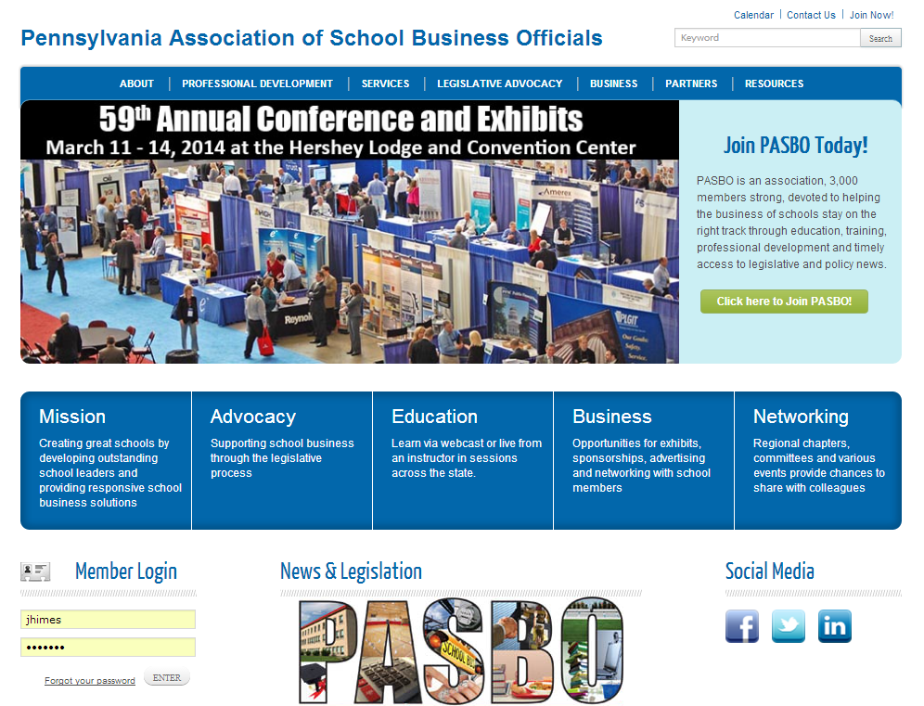

Slide 30
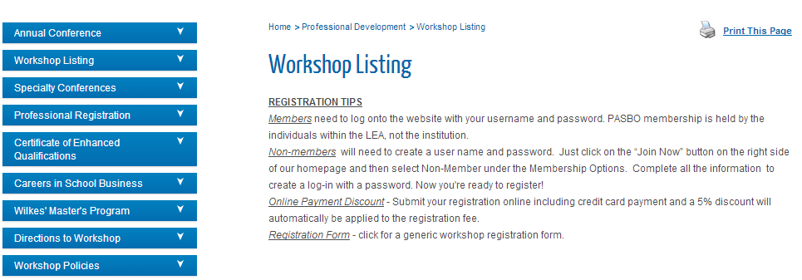
Build a Solid Foundation with Elements & Applications Workshops
For a complete course listing, visit http://www.pasbo.org/workshops

Slide 31
There’s a doc for that…
at the Electronic Resource Center
www.pasboerc.org
Delivering Best Practices and Good Ideas

Slide 32
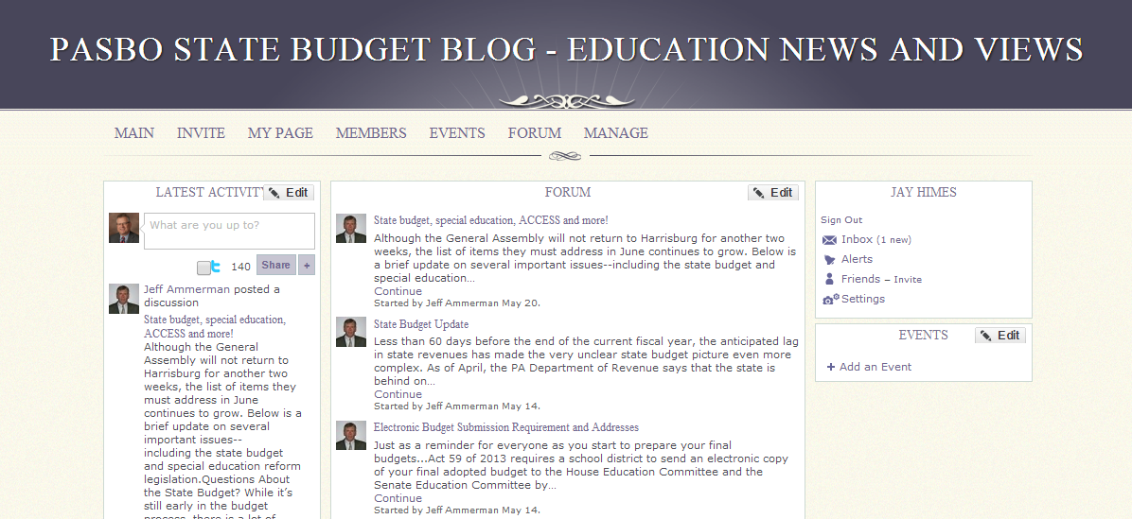
The PASBO State Budget Blog
Invitation only site related to the State Budget
If you have not yet signed up, please send an email to jammerman@pasbo.org
Sign-up is easy
Try to send out messages when updates occur, but check once a week just in case

Slide 33
Follow PASBO
Add PASBO to your social networks
Like PASBO

Slide 34
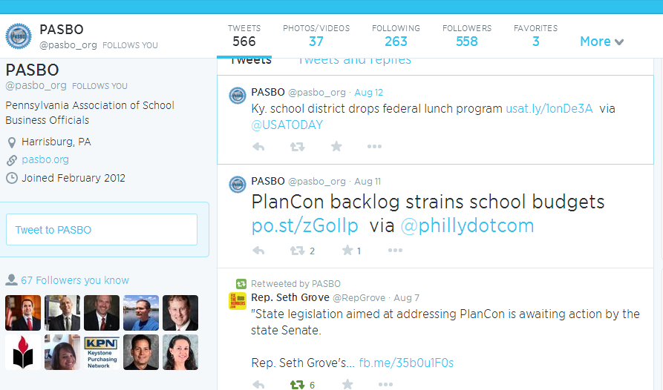

Slide 35
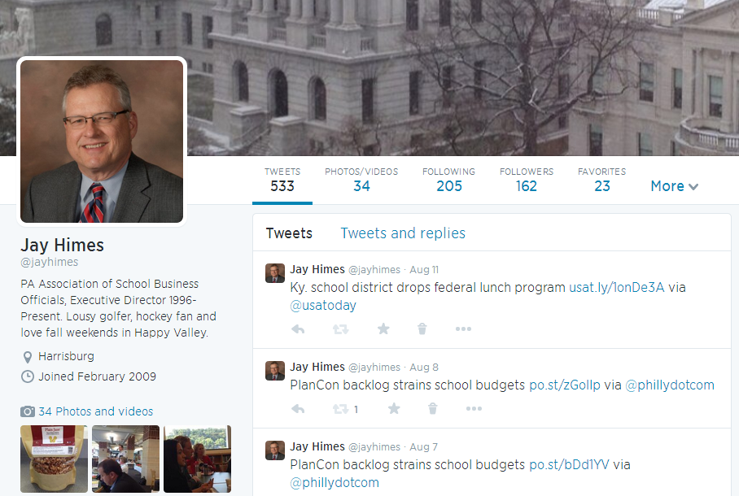
@jayhimes

Slide 36
Streamline your procurement payment process—and earn a rebate! It’s a return on expenditure!
Easily manage your cards and earn rebates for your LEA with every purchase
For more info visit www.easyprocure.org

Slide 37
Quickly and easily solicit bids for supplies, services, contracts and other purchases for your LEA

Slide 38
Have surplus equipment?
Sell it with
Reach a wider audience
No Fees for sellers
Greater ROI for your surplus Items
Easy to use and free training is provided
For more information, visit www.pasbo.org/PublicSurplus

Slide 39
Increase your buying power with
Savings from leading suppliers
Office supplies & furniture
Fleet vehicle parts
Food products and distribution services
And more!
For more information, visit www.pasbo.org/uscommunities

Slide 40
Time for Questions!
Send text questions using the “Chat” function at the left side of your screen.
Type message in box and click “Enter” to send.

Slide 41
Thank you for your participation!
CPE and CEU Credits are not available for this forum.

