Slide 1
Thanks for Joining Us!
Listen to audio over your computer speakers. If you are not able to listen via the Internet, you can dial-in by phone using the numbers shown on your screen.
If you disconnect, simply repeat instructions to reconnect to the program.
If listening to audio by phone, you can adjust the volume by pressing *4.
To submit a question, type in the chat window and click “Enter” to send.
CPE and CEU Credits are NOT available for this forum.

Slide 2
Welcome to the Second Installment of FYI
Our Intent and Purpose
Strategic Plan Outreach and Mentorship Effort for New and Newer PASBO Members in all aspects of School Business Management
Use PASBO Experts to Help New Entrants
Continuing Series
April 4 at 1:30 p.m.
May 9 at 9:00 a.m.
June 13 at 9:00 a.m.
Who Are You?—Let’s Find Out

Slide 3
Today’s Agenda
What's New and What's Due
A Summary of Reporting Requirements to Keep You in Compliance
Calendar of State and Federal Reports
From the Experts
How To Be A More Effective School Business Official
The Latest and (Not So) Greatest in School Business
A Quick Scan of School Business Management Issues from Across the State
PASBO Tools You Can Use
Resources to Help You
Your Questions Answered
An Open Forum for Your Questions About Topics Covered and Uncovered!

Slide 4
Today’s Expert: Charles E. Linderman, PRSBA
Born in Coatesville, PA, he currently resides in Malvern with his wife Diane. A graduate of the Owen J. Roberts school system, he has been employed at Great Valley School District since 1981. Chuck and Diane have 2 children who both graduated from Great Valley.
After graduation from Shippensburg State College in 1979, he was employed by Shared Medical Systems where he served as a Tax Accountant. He started driving a school bus for Great Valley part-time in 1979 and was hired in 1981 as the Payroll/Benefits Accountant. In 1982 he also assumed the duties of the Food Service director. In 1984 he was named the Administrative Assistant for business and was named the Director of Business Affairs in 1985 which he still performs. As the Business Administrator he is in charge of Finance, Facilities, Transportation, Technology, and Food Services. He is also the lead negotiator for the district with the labor contracts and overseas the hiring of all support personnel and he serves as the Secretary to the Great Valley School Board.
In 1983 he earned his MBA from Widener University.

Slide 5
Charles E. Linderman, PRSBA
PASBO Board of Directors 1993-2000 (President in 1998-1999)
ASBO International Board of Directors 2007-2012 (President in 2011).
Gary Reeser Award Recipient (2005)
President, PASBO (1998-1999)
President ASBO International (2011)
ASBO Eagle Award Recipient (2005)
PSDLAF Board of Trustees (2001- Present)
PSDLAF Chairman (January 2012 – December 2013)

Slide 6
Before We Start
The due dates on the calendar are intended as a guide not as absolute deadline dates.
The calendar is a work in progress and will be modified throughout the year.
This is not an “official” calendar although it has been reviewed by PDE.

Slide 7
Schedule of Reporting Deadlines First Quarter 2014
Due Date | Report Name/Form Number | Frequency | Explanation | Functional Area | Where to file
1-Feb | New Hire Report | Monthly | Report of New Hires | HR | Dept. of Labor & Industry
1-Feb | NSL Report on PEARS | Monthly | Reimbursement for Lunches Served each Month | Food Service | CN PEARS
1-Feb | On-Site Review Before February 1 | Annual | Audit of Lunches Served in each Building | Food Service
4-Feb | Act 1 Opt Out Resolution/Tax Rate | Annual | Copy of Act 1 Opt Out Resolution and proposed tax rate increase-if not applying for exceptions | Finance | PDE
10-Feb | Upload NPAS Reports and Send On-line | Monthly | Report of Wages & Retirement Contributions | Finance | PSERS
19-Feb | Cert. of Use of PDE-2028 | Annual | Submit copy where district does not intend to adopt preliminary budget | Finance | PDE
24-Feb | PDE-2028/Real Estate Tax Rate Report | Annual | Preliminary Budget and related proposed tax rate increases | Finance | PDE

Slide 8
Schedule of Reporting Deadlines First Quarter 2014
Due Date | Report Name/Form Number | Frequency | Explanation | Functional Area | Where to file
1-Mar | New Hire Report | Monthly | Report of New Hires | HR | Dept. of Labor & Industry
1-Mar | NSL Report on PEARS | Monthly | Reimbursement for Lunches Served each Month | Food Service | CN PEARS
1-Mar | Upload NPAS Reports and Send On-line | Monthly | Report of Wages & Retirement Contributions | Finance | PSERS
6-Mar | Referendum Exception Application | Annual | Application for Act 1 referendum exceptions | Finance | PDE
10-Mar | 2030 | Quarterly | Reconciliation of cash on hand | Finance | Comptroller
21-Mar | Voter Referendum Question | Variable | Submit referendum question to voters to raise taxes above Act 1 Index without exceptions | Finance | County Election Officials
25-Mar | Retirement Payment | Quarterly | PSERS Q4 Employer Payment | Finance | PSERS
31-Mar | Dept. of Revenue PIT Filers | Annual | Re-assignment of taxpayers who do not live in the district (Act 80) | Finance | Dept. of Revenue
31-Mar | Dept. of Labor &Industry UC-2 | Quarterly | Report of Unemployment Comp. Wages | Finance | Dept. of Labor & Industry
31-Mar | Fuel Tax Refund | Annual | Fuel Tax Refund Report | Finance | Dept. of Revenue

Slide 9
Schedule of Reporting Deadlines First Quarter 2014
Due Date | Report Name/Form Number | Frequency | Explanation | Functional Area | Where to file
31-Mar | PDE-4625 | Annual | Temporary Assistance to Needy Families | Finance | PDE
31-Mar | Earned Income Tax | Quarterly | Report of Local Wage Tax Withholdings | Finance | Local EIT Collector
31-Mar | IRS- 941 | Quarterly | FICA & Federal Income Tax | Finance | IRS
31-Mar | PA Dept. of Revenue | Quarterly | Report of State Tax Withholdings | Finance | Dept. of Revenue
31-Mar | PDE-339 (Act 29) | Quarterly | Social Security & Medicare Contributions | Finance | PDE
31-Mar | PSERS – Employer Contribution | Quarterly | Deposit of Employer Retirement Due | Finance | PSERs
31-Mar | All State and Federal Grant reporting | Quarterly | Submit all grant reporting for State and Federal programs. | Finance
31-Mar | Voter Referendum Question | Variable | Submit referendum question to voters if PDE denied Act 1 exceptions | Finance | County Election Officials
31-Mar | 819 | Quarterly | Sales and Use Tax Report | Finance | Dept. of Revenue

Slide 10
Sources of Filing and Reporting Info
PIMS Data Collection Calendar
http://www.portal.state.pa.us/portal/server.pt/community/pims-pennsylvania_information_management_system/8959
Comptroller Forms
http://www.portal.state.pa.us/portal/server.pt/community/forms_and_procedures/13472
Food Service Calendar
http://www.portal.state.pa.us/portal/server.pt/community/national_school_lunch/7487/activity_calendar/964588

Slide 11
Getting Comfortable in Your Position: Relax and Take Control
Chuck Linderman
Director of Business Affairs/Board Secretary
Great Valley School District
clinderman@gvsd.org
(610) 889-2125, ext. 2123

Slide 12
Working with the School Board
Remember the Boy Scout Motto
“Be Prepared”
Too much is better than not enough
Don’t be afraid say you don’t know
But always offer to find out the answer
Remember to keep things at a high level and very simple
Remember you have all the answers (or can get them)
Don’t give them new questions, just answers
Try to know a little about a lot of things and not a lot about any one thing.

Slide 13
Business Office
Probably the busiest time for the Business Office
Budget (Act 1)
Deciphering the Governors Budget
Bids
Personnel
Always make time for questions from your staff
Make every inquiry an important one

Slide 14
Operations and Maintenance
Still licking our wounds from the winter
Access the damage from the winter
Finalize Capital Projects for the Summer
Re-Tool the Long Range Maintenance Plan
Check in with the Crew

Slide 15
Technology
Review the Technology projects for the summer
Review the Long Term Technology Plan
Assess the strength of your network

Slide 16
Student Transportation
Review Routes for following year
Look at possible savings
Consolidation of Stops
Sharing of services with other districts
Especially the Non-Publics
Review the Preliminary numbers submitted to PDE

Slide 17
Human Resources
Open enrollment for health care in most schools is April-May
Possible retirements
Staffing for next year
Develop an interview schedule

Slide 18
Food Service
Self-Op’s should meet with the Business Manager to review the Profit/Loss statement
Not too late to make some adjustment
Consider Approaching Private and Parochial School in your area to act as their contract
Marginal Cost of 1 additional Meal is very small
Marginal Profit for that Meal is high

Slide 19
Jeff Ammerman, PASBO Director of Technical Assistance
Previous business manager at State College Area SD, South Middleton SD, and Philipsburg-Osceola Area SD
Worked in the Business Office at Tuscarora Intermediate Unit
Part of my role at PASBO is to answer questions for members
jammerman@pasbo.org, 717-540-9551

Slide 20
Act 1 Timeline-Preliminary Budget
If Act 1 tax limiting resolution not passed, must prepare Preliminary Budget
Budget should be made available on PDE 2028 at least 20 days before adoption
Must advertise intent to adopt Preliminary Budget 10 days before adoption
Must adopt Preliminary Budget by February 19
Must submit Preliminary Budget to PDE both electronically and via paper by February 24

Slide 21
Act 1 Exceptions
If exceptions are being sought, must advertise intention to apply for exceptions by February 27
To be able to apply for exceptions, Preliminary Budget must have a real estate tax rate increase greater than the Act 1 index
It is the rate increase that determines the ability for exceptions, not the total growth in real estate tax revenue
Apply for exceptions using the RES system on MY PDE

Slide 22
Act 1 Exceptions
You must be granted access to RES system by your local security administrator
If unsure who that is, help at the state level can be found at the link below:
www.portal.state.pa.us/portal/server.pt/community/department_information/7203/help_and_support/510956

Slide 23
RES System Picture

Slide 24
RES Submission
Must submit exceptions electronically by March 6 (fill out exceptions and then hit Submit to PDE)
Must also submit a certification signed by your Superintendent (Certification tab at top of screen)
Only four allowable exceptions: Grandfathered Debt, Electoral Debt, Special Education Expenses, and Retirement Contributions
For debt exceptions contact your financial advisor
Special Education and Retirement exceptions are mostly filled in by PDE data, you will need to input very little

Slide 25
Treasure Trove of Act 1 Resources
http://www.pasbo.org/act1info

Slide 26
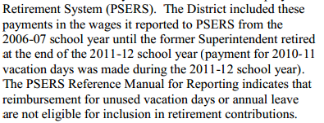

Slide 27
Hone your skills at the PASBO 59th Annual Conference & Exhibits
http://files.pasbo.org/conf_annual.asp
At the PASBO Conference and Exhibits, take advantage of:
More than 100 seminars, mini-seminars, help desks and computer labs devoted to strategies you can use in all facets of school business
Flexible registration options to help you to maximize your investment of time and resources
The expansive exhibit floor with more than 250 booths featuring the latest products and services to benefit your LEA
Networking opportunities with colleagues from across the state
Can't make the trip to Hershey? Register for the Conference Webcast option and participate in 8 conference seminars by live webcast.

Slide 28
Build a Solid Foundation with Elements & Applications Workshops
ELEMENTS OF FACILITIES MANAGEMENT - March 26 in Mars & March 27 in Kulpsville
ELEMENTS OF FOOD SERVICE ADMINISTRATION - January 28 in Mars & January 30 in Kulpsville
ELEMENTS OF PURCHASING - April 9 in Harrisburg
ELEMENTS OF SCHOOL LAW - April 2 in Kulpsville & April 3 in Mars
ELEMENTS OF TRANSPORTATION - May 6 in Harrisburg
APPLICATIONS IN DATA MANAGEMENT - Online Course (January 27 through February 28)
APPLICATIONS IN REVENUES - May 1 in Harrisburg
For a complete course listing, visit http://www.pasbo.org/workshops

Slide 29
A “must attend” for all people new to a position in school business.
School Operations Academy
July 24-25, 2014
Penn State Conference Center
State College, PA
Tracks in Business, Facilities, Food Service and Transportation will help you to:
learn proven techniques from experienced practitioners
gain ideas to create efficiencies and reduce costs
exchange challenges and solutions with your peers
build a network of contacts across the state

Slide 30
Valuable Benefits
Our members share a common goal.
To support classroom learning in schools during good and bad economic times through smart business practices.
PASBO helps make that goal a reality.
Connect for Professional Networking Opportunities
Stay Abreast of State policy and Legislative Developments
Maximize Professional Growth and Career Opportunities

Slide 31
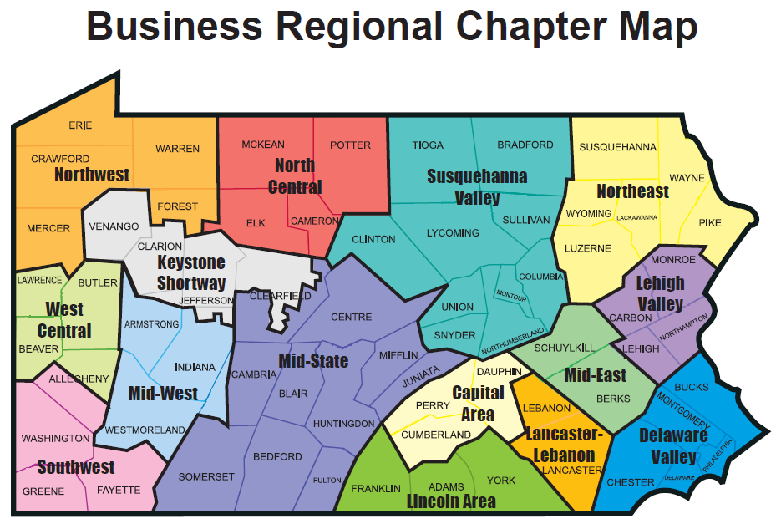

Slide 32
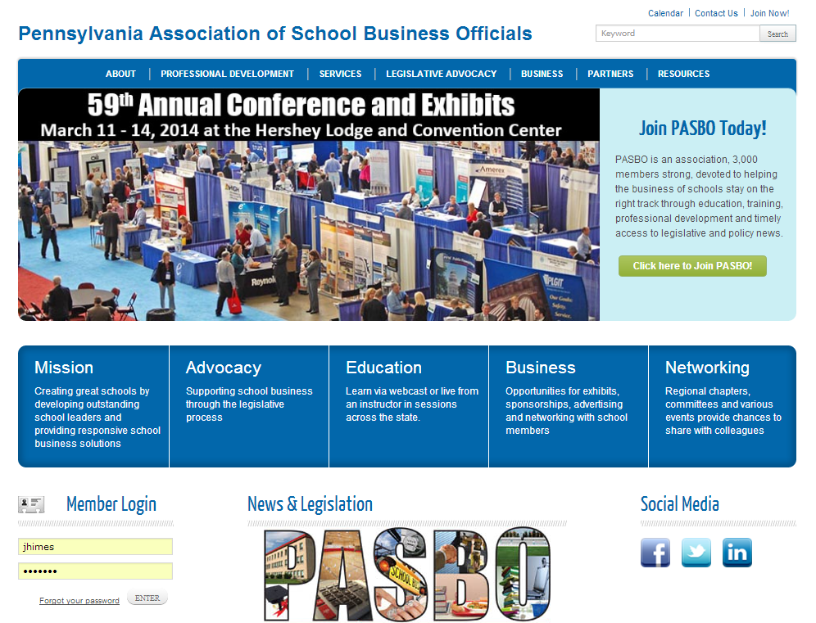

Slide 33
There’s a doc for that…
at the Electronic Resource Center
www.pasboerc.org
Delivering Best Practices and Good Ideas

Slide 34
Quickly and easily solicit bids for supplies, services, contracts and other purchases for your LEA

Slide 35
PSDLAF (or the “Fund”) is a full-service cash management program that has been designed and customized to provide an efficient set of benefits and enhancements for managing Pennsylvania public funds. PSDLAF was created in 1982 by PASBO (the Pennsylvania Association of School Business Officials) and PSBA (the Pennsylvania School Boards Association), who for more than 30 years have sponsored the Fund.

Slide 36
Increase your buying power with
Savings from leading suppliers
Office supplies & furniture
Fleet vehicle parts
Food products and distribution services
And more!
For more information, visit www.pasbo.org/uscommunities

Slide 37
Looking for great customer service?
For more information, visit http://www.pasbo.org/pics.asp

Slide 38
Have surplus equipment?
Sell it with
Reach a wider audience
No Fees for sellers
Greater ROI for your surplus Items
Easy to use and free training is provided
For more information, visit www.pasbo.org/PublicSurplus

Slide 39
For More Information on PASBO Benefits and Services

Slide 40
Time for Questions!
Send text questions using the “Chat” function at the left side of your screen.
Type message in box and click “Enter” to send.

Slide 41
Thank you for your participation!
CPE and CEU Credits are not available for this forum.

