Slide 1

Thanks for Joining Us!
Listen to audio over your computer speakers. If you are not able to listen via the Internet, you can dial-in by phone using the numbers shown on your screen.
If you disconnect, simply repeat instructions to reconnect to the program.
If listening to audio by phone, you can adjust the volume by pressing *4.
To submit a question, type in the chat window and click “Enter” to send.
CPE and CEU Credits are NOT available for this forum.

Slide 2
Welcome to FYI
Our Intent and Purpose
  Strategic Plan Outreach and Mentorship Effort for New and Newer PASBO Members in all aspects of School Business Management
  Use PASBO Experts to Help New Entrants
  Continuing Series
    Next one is February 13, 2015 at 9 am
    All sessions recorded and available
    at www.pasbo.org/FYI

Slide 3
Today’s Agenda
What's Due
  Calendar of State and Federal Reports
Purchasing Rules
PASBO Tools You Can Use
  Resources to Help You
Your Questions Answered
  An Open Forum for Your Questions About Topics Covered and Uncovered!

Slide 4
Before We Begin
Polling Questions
Do you spend most of your time in the purchasing function?
Yes, No.
Indicate how much time you do spend in purchasing.
More than half of my time
Less than half of my time
Only a small percentage of my time

Slide 5
What’s Due

Slide 6
Sources of Filing and Reporting Info
PIMS Data Collection Calendar
http://www.portal.state.pa.us/portal/server.pt/community/pims-pennsylvania_information_management_system/8959
Comptroller Forms
http://www.portal.state.pa.us/portal/server.pt/community/forms_and_procedures/13472
Food Service Calendar
http://www.portal.state.pa.us/portal/server.pt/community/national_school_lunch/7487/activity_calendar/964588

Slide 7
Sources of Filing and Reporting Info
PIMS Data Collection Calendar
http://www.portal.state.pa.us/portal/server.pt/community/pims-pennsylvania_information_management_system/8959
Comptroller Forms
http://www.portal.state.pa.us/portal/server.pt/community/forms_and_procedures/13472
Food Service Calendar
http://www.portal.state.pa.us/portal/server.pt/community/national_school_lunch/7487/activity_calendar/964588

Slide 8

Today’s Expert, Jeffrey Ammerman
Previous business manager at State College Area SD, South Middleton SD, and Philipsburg-Osceola Area SD
Worked in the Business Office at Tuscarora Intermediate Unit
Answer Man: Part of his role at PASBO is to answer questions and provide technical information to members
jammerman@pasbo.org, 717-540-9551

Slide 9
Purchasing Rules
PASBO Members have access to a free Purchasing Manual
Go to the PASBO Store at the link below
http://www.pasbo.org/store_product.asp?prodid=55

Slide 10
Purchasing Rules
No school director shall, during the term for which he is elected or appointed, as a private person engage in any business transaction with the school district, be employed in any capacity by the school district in which he is elected or appointed, or receive any pay for services rendered except where explicitly provided by statute (24 P.S. §3-324).

Slide 11
Purchasing Rules
No school board director shall draw, cause to be drawn, or accept a specification for any item to be purchased by the school district that would limit the purchase of the item to the firm, corporation, partnership or other business entity of which a school director is an officer, agent or employee and exclude all other persons who could submit quotations or bid on an equivalent item (24 P.S. §3-324).

Slide 12
Purchasing Rules
It shall not be a violation for a school district to contract for the purchase of goods or services from a business with which a school director is associated to the extent permitted by and in compliance with 65 Pa.C.S. Ch. 11 (relating to ethics standards and financial disclosure)

Slide 13
Purchases from Employees Prohibited
No person shall act as agent for school books or school supplies, in any district in which he is engaged or employed as a superintendent, teacher, or employee of the school district in any capacity, or in which he was thus employed during the preceding school year

Slide 14
Purchasing Rules
A majority vote of the board of school directors is required when action is taken in certain listed instances, including but not limited to, entering into contracts for supplies over one hundred dollars ($100.00).
Action taken without the required approval of the board of school directors is void and unenforceable.

Slide 15
Quotation Threshold
Quotations are required under section 807.1 for all purchases from a base amount of $10,500 to $19,400 for calendar year 2015.
Threshold adjusts every January
New thresholds published in PA Bulletin in December (PABULLETIN.COM)

Slide 16
Quotation Rules
Written or telephonic price quotations from at least three (3) qualified and responsible vendors shall be requested
Written price quotations, written records of telephonic price quotations and memoranda shall be retained for a period of three (3) years
Emergencies do not exempt the need for obtaining quotes

Slide 17
Bid Threshold
Supplies costing $19,400 or more shall be purchased by the board of school directors only after public notice has been given by advertisement once a week for three (3) weeks in not less than two (2) newspapers of general circulation.
In any district where no newspaper is published, said notice may, in lieu of such publication, be posted in at least five (5) public places.
Bid threshold also adjusts every January

Slide 18
Bid Rules
The board of school directors shall accept the bid of the lowest responsible bidder— kind, quality and material being equal—but shall have the right to reject any and all bids, or select a single item from any bid.
Important to write bid specifications so that clear judgments can be made

Slide 19
Breaking Up Purchases to Evade Rules is Prohibited
No board of school directors shall evade the provisions of this section as to advertising for bids or purchasing materials piecemeal for the purpose of obtaining prices less than the bid threshold which should, in the exercise of reasonable discretion and prudence, be conducted as one transaction

Slide 20
Construction Work
Separate section of school code has the same quote/bid thresholds for construction, reconstruction, repairs, maintenance or work of any nature, including the introduction of plumbing, heating and ventilating or lighting systems upon any school building or school property

Slide 21
Additional Rules for Construction Projects
The Department of Labor and Industry, through the Bureau of Labor Law Compliance, determines prevailing wage rates for the construction industry and enforces the rates and classifications under heavy, highway and building construction projects of $25,000 or more when public funds are involved.
More information at http://www.portal.state.pa.us/portal/server.pt/community/prevailing_wage/10519

Slide 22

Quickly and easily solicit bids for supplies, services, contracts and other purchases for your LEA

Slide 23
Emergency Bid Public Advertisement Waiver
Section 751 of the Public School Code provides if, due to an emergency, a school plant or any part thereof becomes unusable, an impacted school district may solicit competitive bids for repairs or replacement from at least three responsible bidders without publicly advertising the bids.

Slide 24
Emergency Bid Waiver
Upon the approval of any of these bids by the board of school directors, the school district may proceed at once to make the necessary repairs or replacements in accordance with the terms of the approved bid or bids.

Slide 25
Work By School Personnel
School district maintenance personnel may be used to perform any construction, reconstruction, repairs or work of any nature where the entire cost is less than $10,400 (adjusted annually)
Use of school district maintenance personnel to perform “maintenance” work without restrictions as to cost.

Slide 26
Items Exempt for Bid/Quote Rules
The following shall be exempt from bidding and quotations: maps, music, globes, charts, educational films, filmstrips, prepared transparencies and slides, pre-recorded magnetic tapes and disc recordings, textbooks, games, toys, prepared kits, flannel board materials, flash cards, models, projectuals and teacher demonstration devices necessary for school use.
Services are also exempt from the requirements

Slide 27
Thresholds
While you are not required to bid items below $19,400, it may be prudent to do so
The same holds true for quote thresholds
Goal is to get best price for your LEA

Slide 28
Cooperative Purchasing
Cooperative purchasing is permitted in Pennsylvania
Can “piggyback” on state contracts
Can purchase through national bid contracts
PEPPM, COSTARS, US Communities, among others

Slide 29

Increase your buying power with
Savings from leading suppliers
Office supplies & furniture
Fleet vehicle parts
Food products and distribution services
And more!
For more information, visit www.pasbo.org/uscommunities

Slide 30
Wrap Up
Many rules related to purchasing
Conflict of interests and ethical violations taken vary seriously
Best to err on the side of caution
Always remember the ultimate goal is to get the best price

Slide 31

Mark Your Calendar

Slide 32

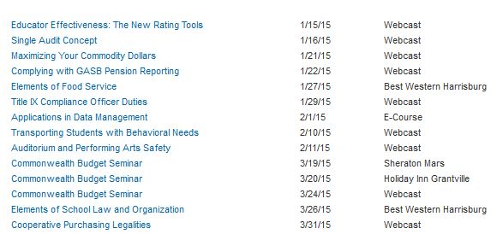

Slide 33

There’s a doc for that…
at the Electronic Resource Center
www.pasboerc.org
Delivering Best Practices and Good Ideas

Slide 34




Follow PASBO
Add PASBO to your social networks
Like PASBO

Slide 35
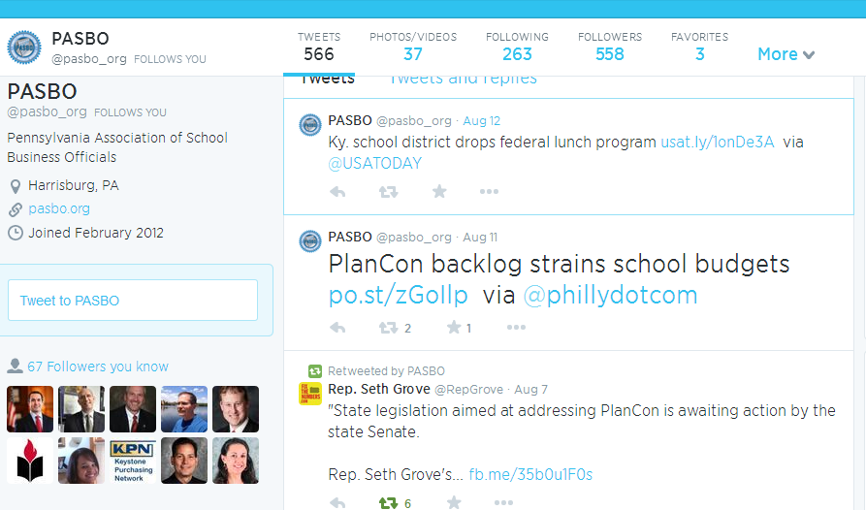

Slide 36

Streamline your procurement payment process—and earn a rebate! It’s a return on expenditure!
Easily manage your cards and earn rebates for your LEA with every purchase
For more info visit www.easyprocure.org

Slide 37

Have surplus equipment?
Sell it with
Reach a wider audience
No Fees for sellers
Greater ROI for your surplus Items
Easy to use and free training is provided
For more information, visit www.pasbo.org/PublicSurplus

Slide 38

Time for Questions!
Send text questions using the “Chat” function at the left side of your screen.
Type message in box and click “Enter” to send.

Slide 39
Thank you for your participation!
CPE and CEU Credits are not available for this forum.
Next FYI is December 12 at 9 am.
Visit pasbo.org/FYI

